Slide 1
The Remote Work Revolution in Data Science Salaries
By Chandrakanth & Ahmed Ali Rao
December 8, 2025

Slide 2
Why and How
Explore trends in data science salaries (2020–2023) across remote, hybrid, and on-site jobs.
Identify key salary factors (job title, experience, location).
Techniques Referenced:
Tufte’s Principles: High data-ink ratio, clear annotation, contextual detail.
Munzner’s Techniques: Faceting (by year/work type), Filtering (work type), Multi-view, Tooltip interaction.

Slide 3
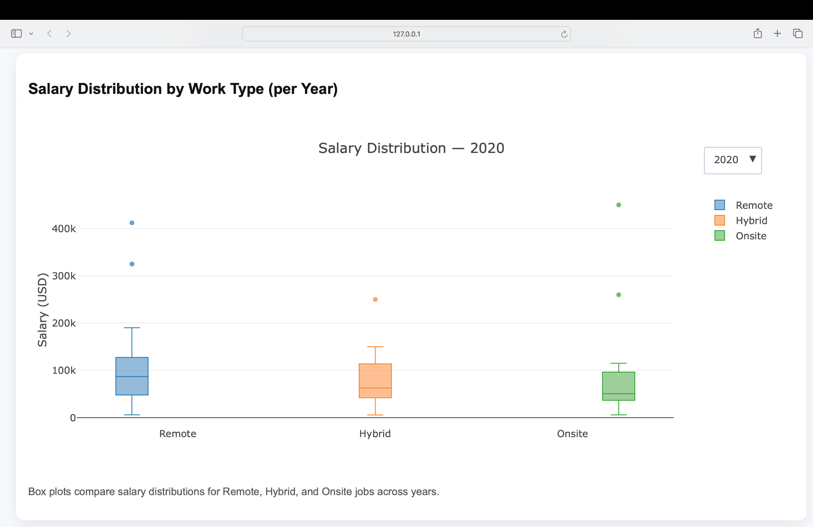
Design (Viz 1 - Salary Distribution by Work Type (per year))
Key Points:
Remote roles generally show higher median salaries and greater variance.
Onsite roles tend to have the lowest salary distribution.
Year-based filtering allows trends to be observed individually.
Reveals shifts in salary dynamics across work types over time.

Slide 4
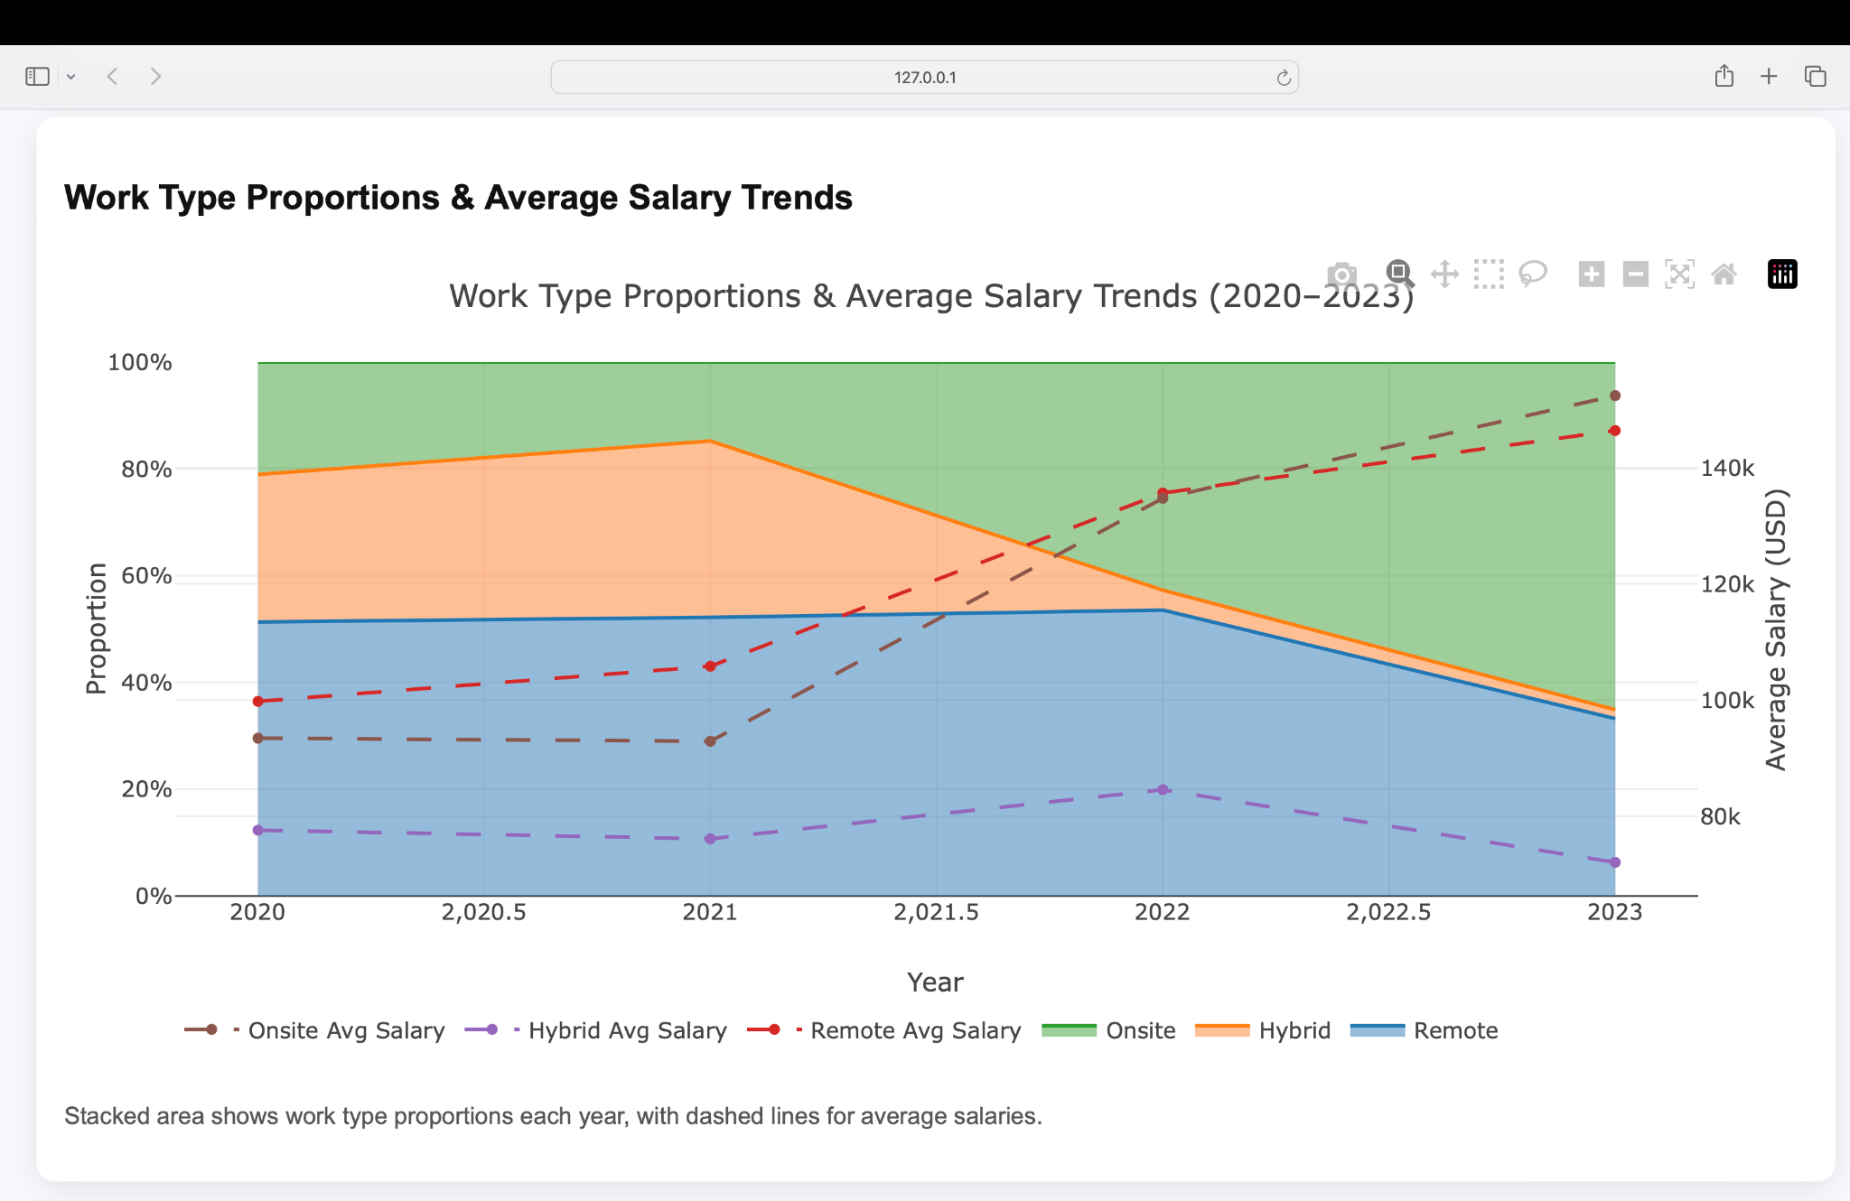
Design (Viz 2 - Work Type Proportions & Average Salary Trends)
Key Points:
Remote jobs grew steadily from 2020–2022, becoming the most common work type.
Onsite roles declined sharply post-2021 as remote work gained dominance.
Hybrid jobs remained stable initially but dropped significantly after 2022.
Remote roles offer the highest average salaries, peaking around $145K in 2023.
Hybrid jobs consistently show the lowest average compensation.
The chart shows how work trends and salaries shifted post-pandemic across different job types.

Slide 5
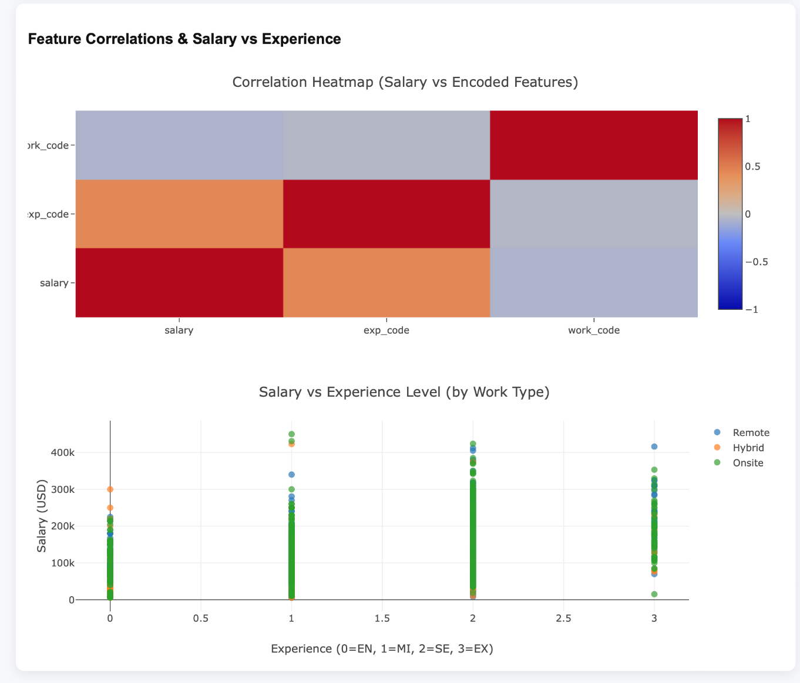
Design (Viz 3 - Work Type Proportions & Average Salary Trends)
Key Points:
Heatmap shows salary correlation with key encoded features like experience level and work type.
Experience level has a strong positive correlation with salary, as expected.
Work type has weaker correlation, suggesting other factors influence salary more heavily.
Bottom plot visualizes salary vs. experience groups (Entry, Mid, Senior, Executive)
Remote executive roles show highest salary outliers compared to hybrid and onsite.
Clear salary progression is visible across experience levels, with exponential jumps at executive level.

Slide 6
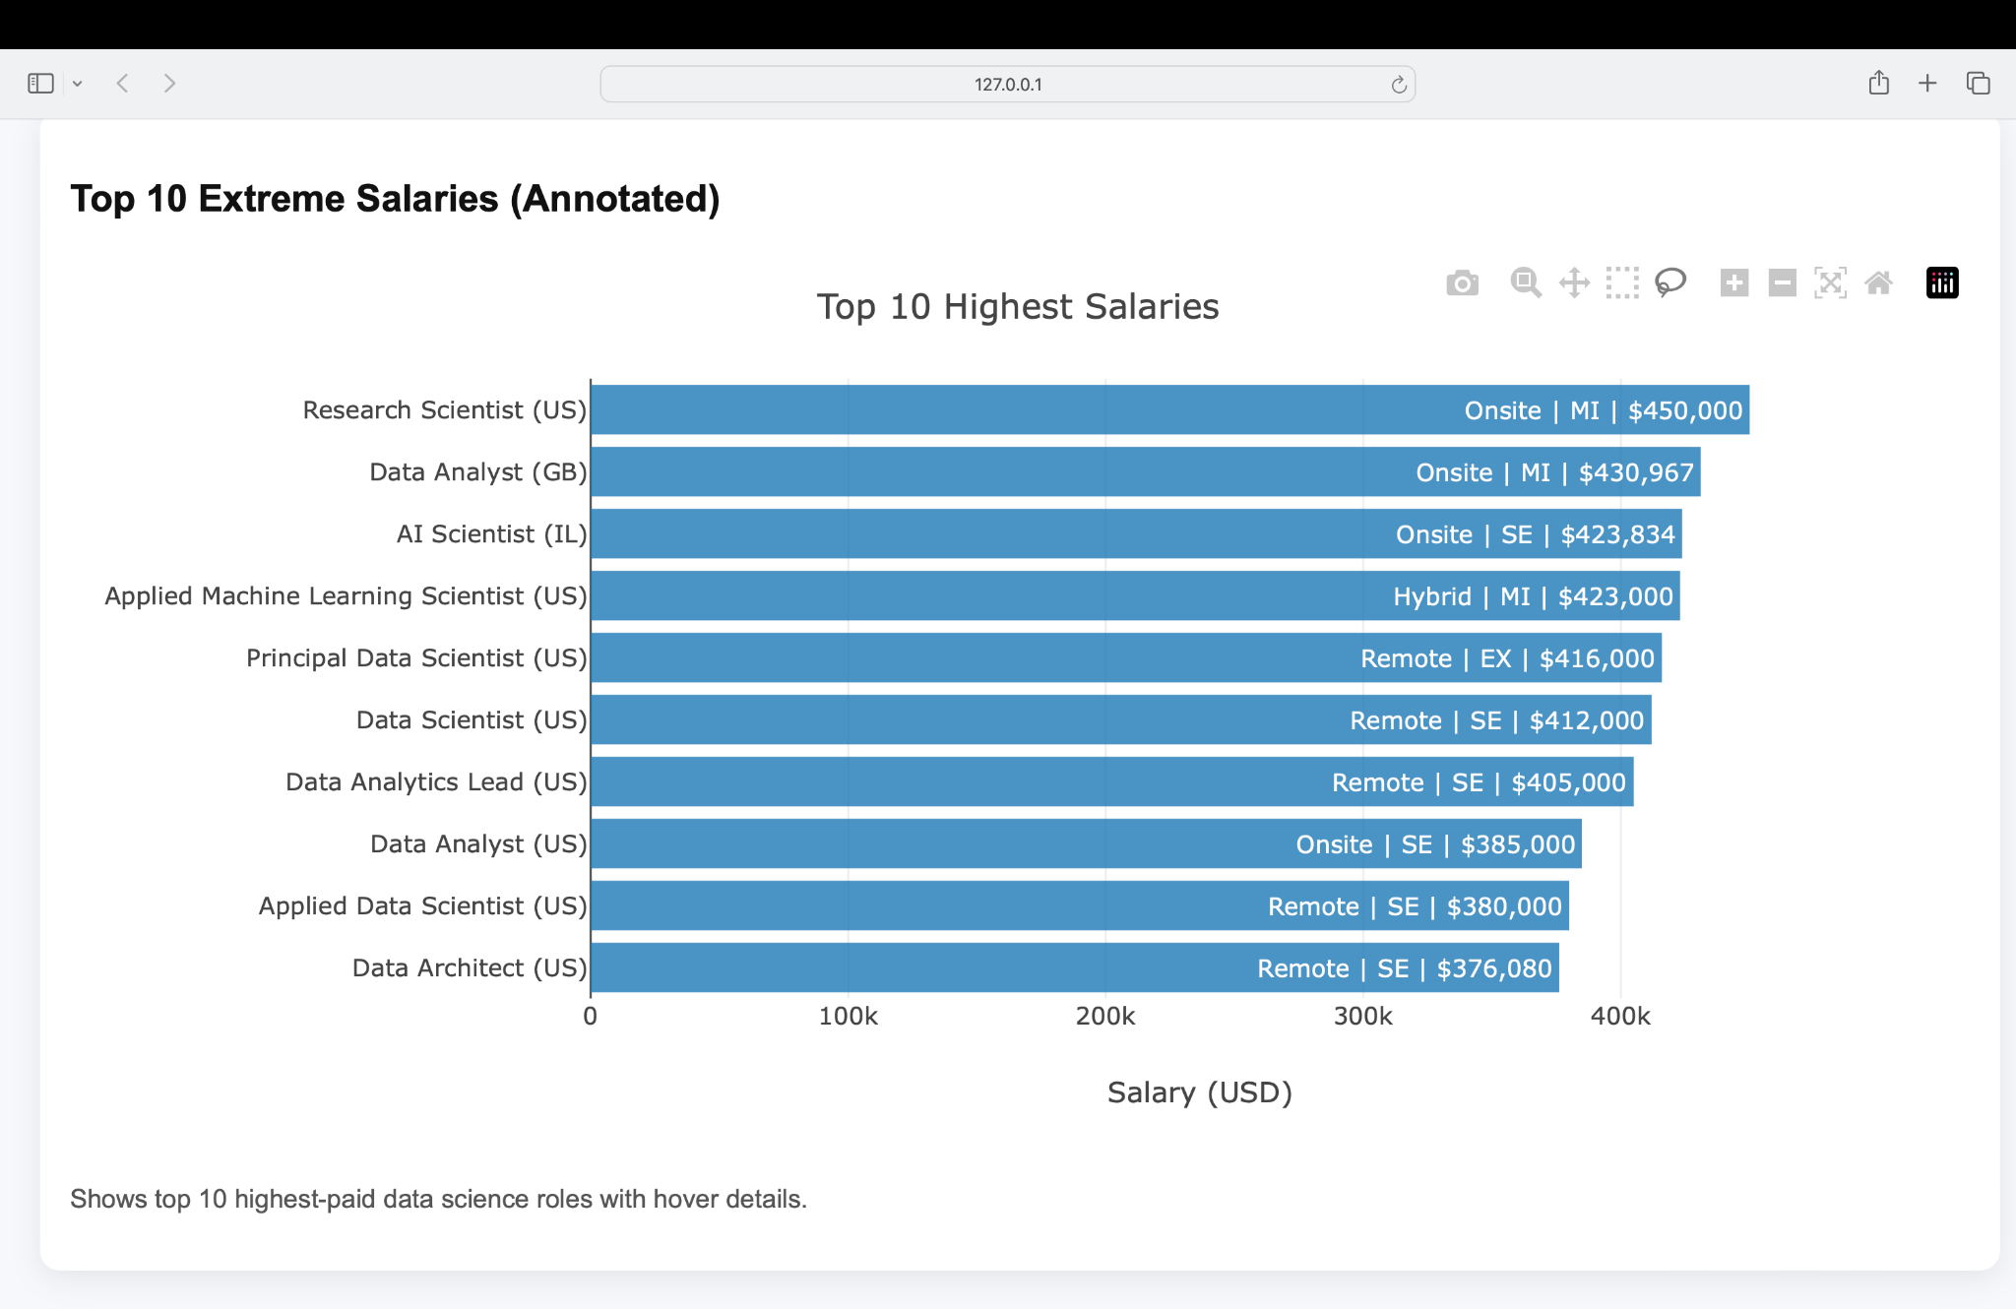
Design (Viz 4 - Top 10 Extreme Salaries (annotated))
Key Points:
Roles span across US, UK, and Europe, with annotations showing location, work type, and experience level.
Research Scientist (US, Onsite, Mid-level) tops the chart at $450K.
Mixture of Remote, Onsite, and Hybrid roles shows flexibility in top-paying positions
Roles include specialized fields like AI Scientist, Data Architect, and ML Scientist.
Visual includes precise salary labels and experience indicators for context.

Slide 7
Discussion
Goals Achieved:
Built 4 interactive visualizations using D3.js
Integrated hover tooltips, filters, and multi-view logic
Analyzed shifts in remote work, salary distribution, and top earners
Implemented all tasks (Compare, Present, Search-Locate, Annotate)

Slide 8
Obstacles and Future Work
Limitations:
Heatmap (feature correlation) not fully implemented
Some job titles were inconsistent (needs preprocessing)
Future Improvements:
Add dropdown filters for job title, country, experience level
Enable animation for year-over-year transitions
Implement clustering on salary groups for better insights

Slide 9
Thank you! Questions?

